Slide 1

Emanuele falzone
Davide molinelli

Slide 2
SUMMARY
Objective
The SENSOR
How it works
SEnsor analysis
Comparison with another sensor
The System
THE LOCAL SYSTEM
THE REMOTE SYSTEM
DEMO

Slide 3
Objective
create a system able to:
Monitor the domestic water flow in real time
Store the data about the consumption on a SD card
Transmit the data on a server

Slide 4
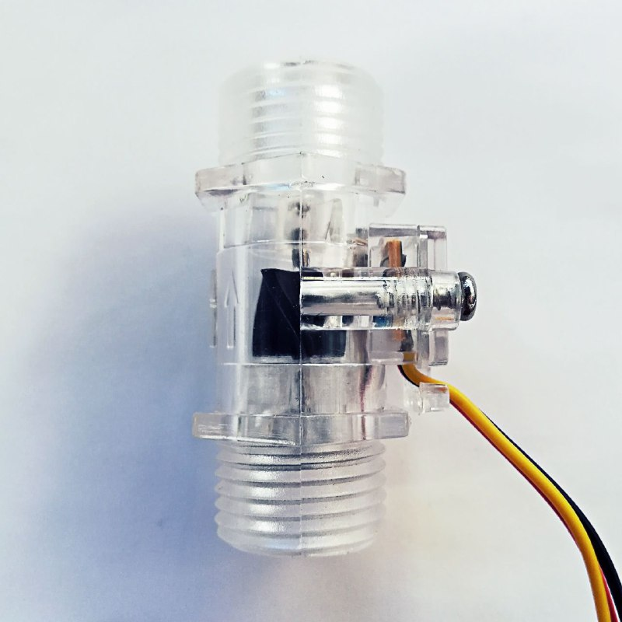
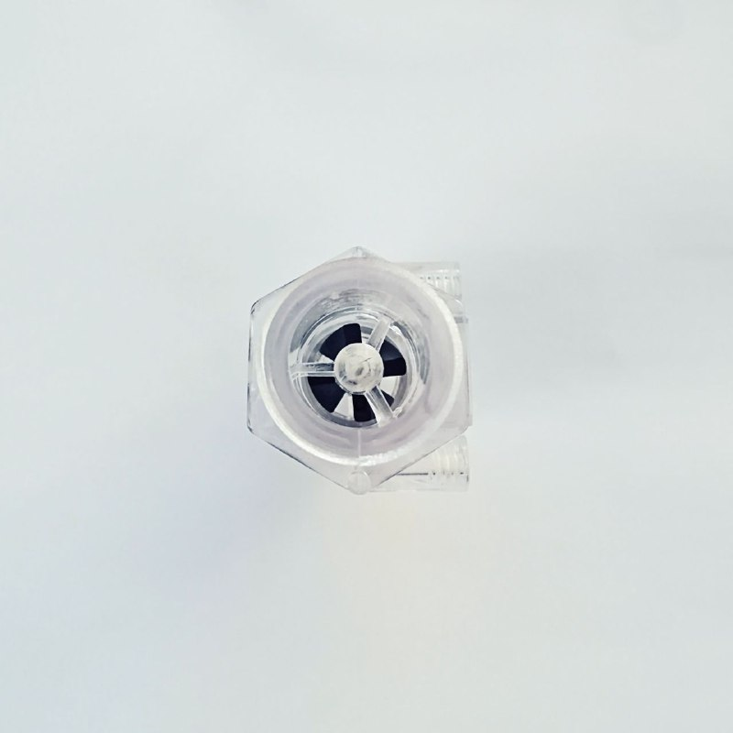
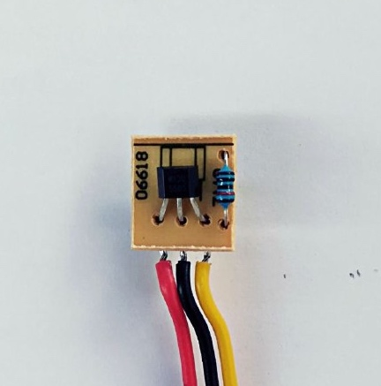
The water-flow sensor

Slide 5
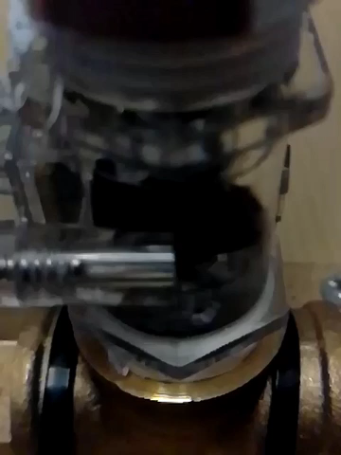

Slide 6
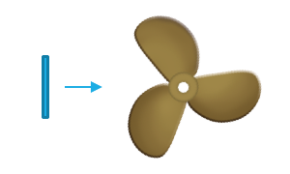
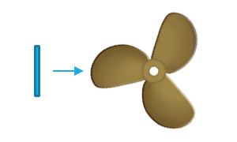
HOW does it work?
LOW MAGNETIC FIELD
HIGH MEGNETIC FIELD

Slide 7
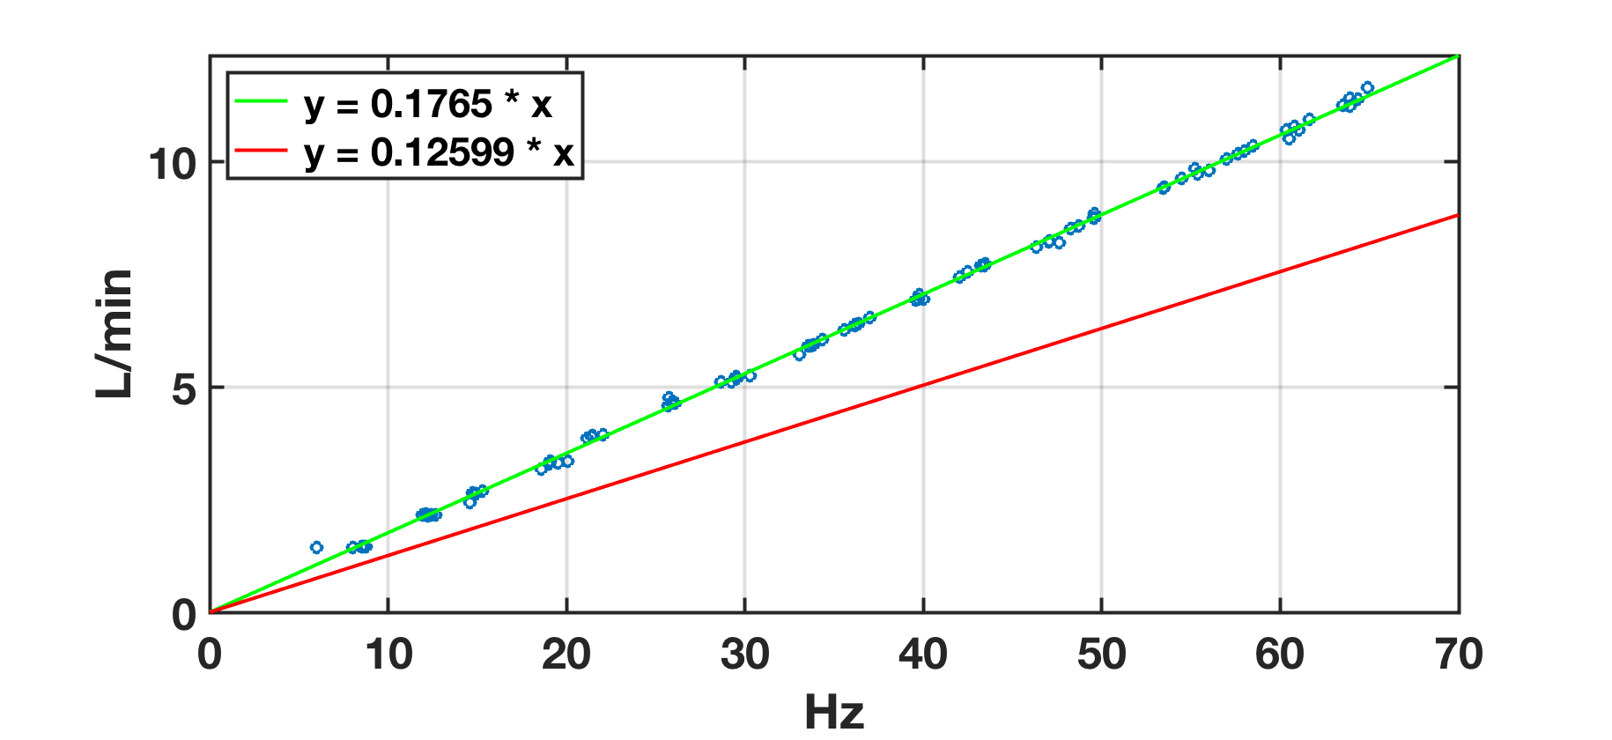
Sensor analysis

Slide 8
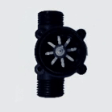
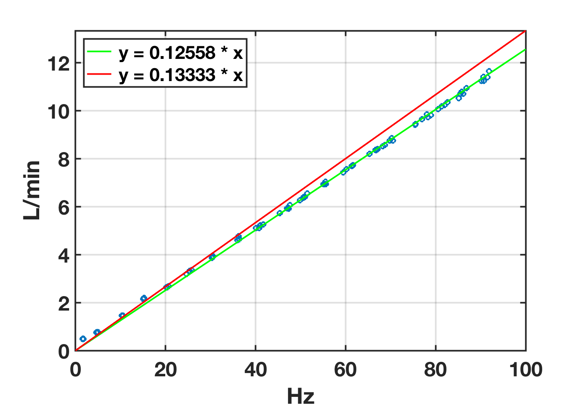
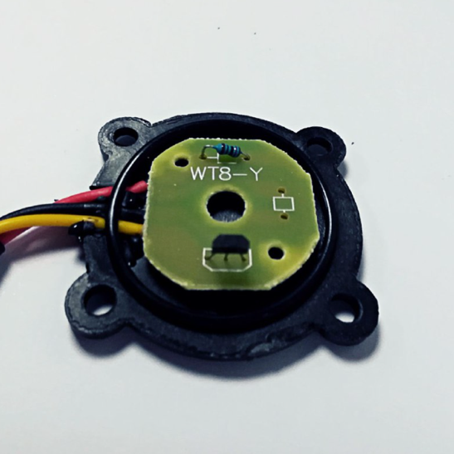
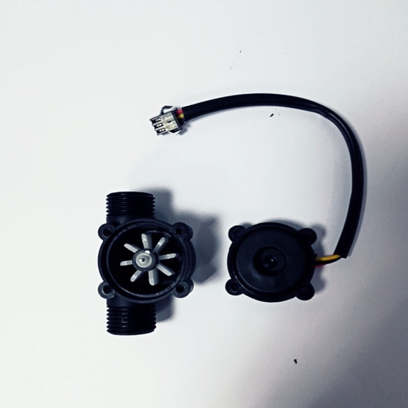
Another sensor

Slide 9
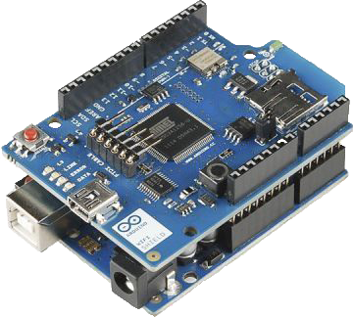
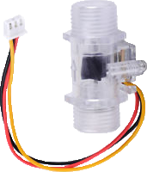
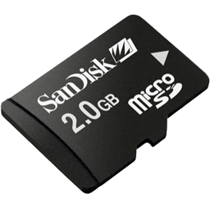

The local system

Slide 10
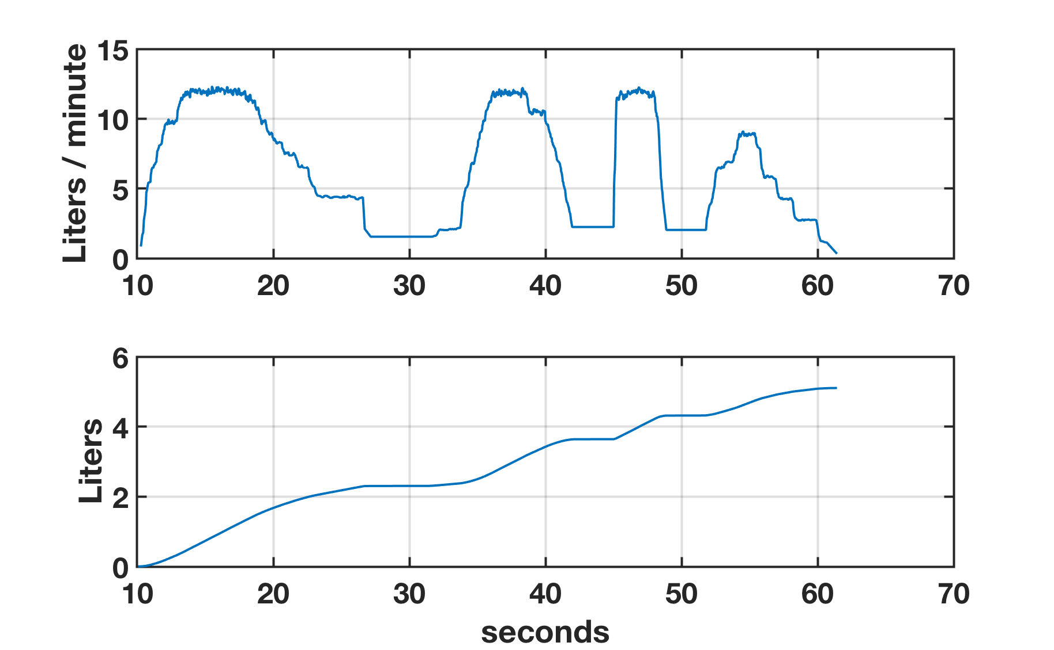
Data analysis

Slide 11



The remote system

Slide 12
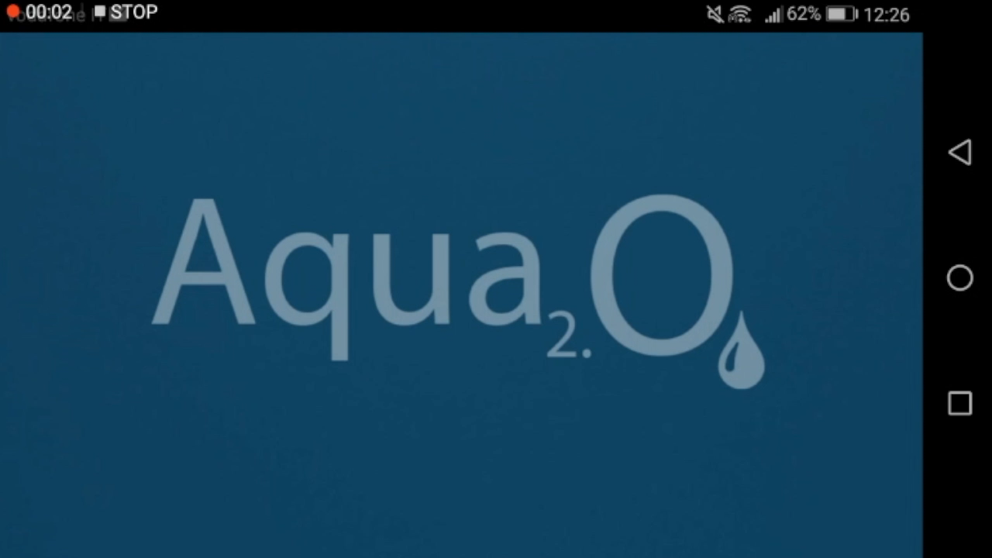

Slide 13
Thank you

